Slide 1

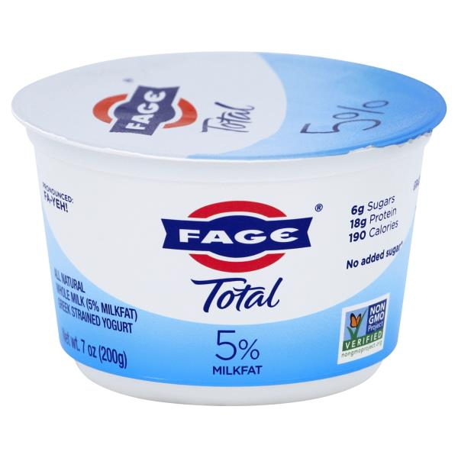
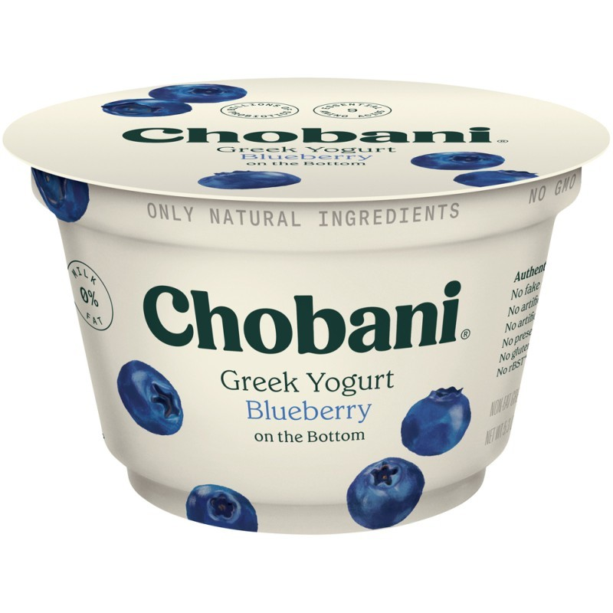
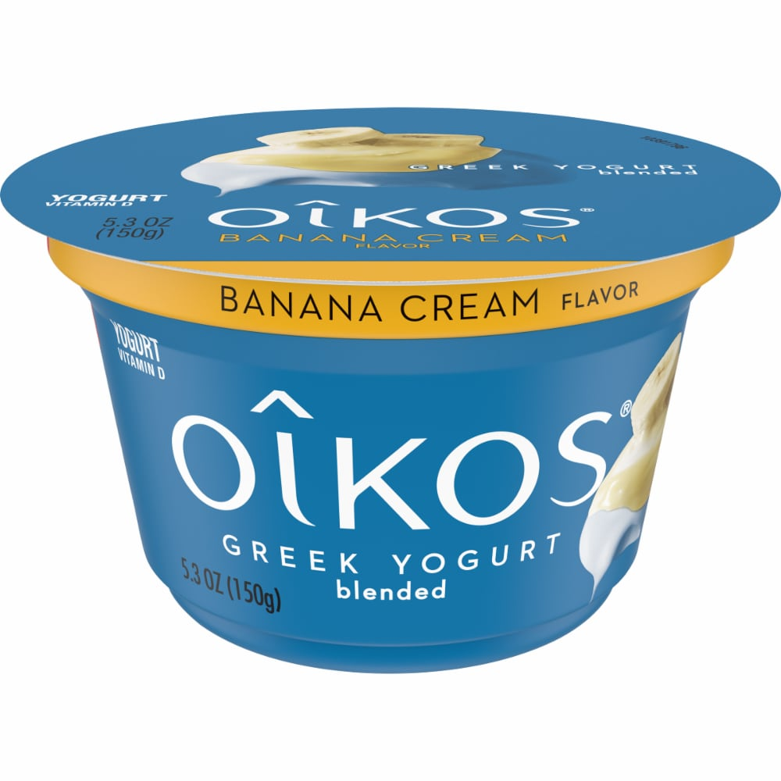
Wegman’s Greek Yogurt
Team D In-Person MSBA
Jessica Zhang, David Chen Lee, Jerry Yang, Himangini Banwari, Michael Chung

Slide 2

Text Mining On Feature Extraction
Cook Normal Sum
Cook People Weighted Sum
Under weighted sum, differences between taste and price are more clear.
Taste is most important element under normal summation
Their preference do not change under different methods.
noncook Normal Sum
Noncook People Weighted Sum
Taste is most important element under weighted summation (more effective way)
Price is the most important element under normal summation.

Slide 3

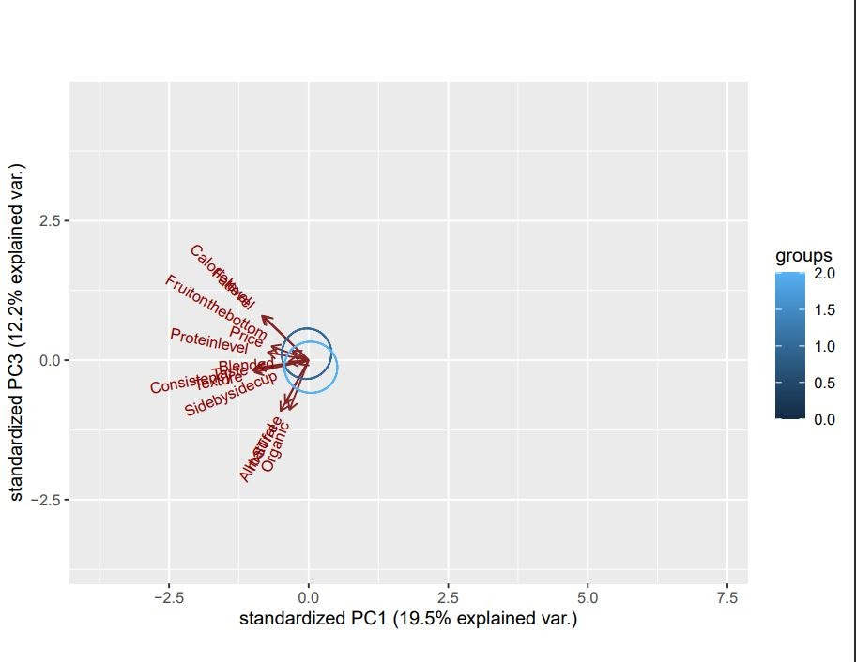
Principal Components Analysis on Yogurt Attributes
Health Group
Organic, all natural, rbSTfree
Can separate into three groups based on PCA plot
Ingredients Group
Protein level, price, fruit on bottom, calorie level, and fat level
Taste Group
Consistency, texture, taste, blended, and side-by-side cup
Use of Greek yogurt for cooking or snacking as a factor is negligible
Notes:
Ultimately, based on the plots, we see that the groups of people who use Greek Yogurt for cooking or as a snack is negligible, since the two circles are very closely intertwined. However, we can observe close correlations between the attributes in the greek yogurt survey. Here, we can make out three groups from this plot of PC1 by PC3.
We can see a closely correlated group forming for the attributes of organic, all natural, and rbSTfree
A group for protein level, price, fruit on the bottom, calorie level, and fat level
Lastly, we see a group forming for consistency, texture, taste, blended, and side by side cup.

Slide 4
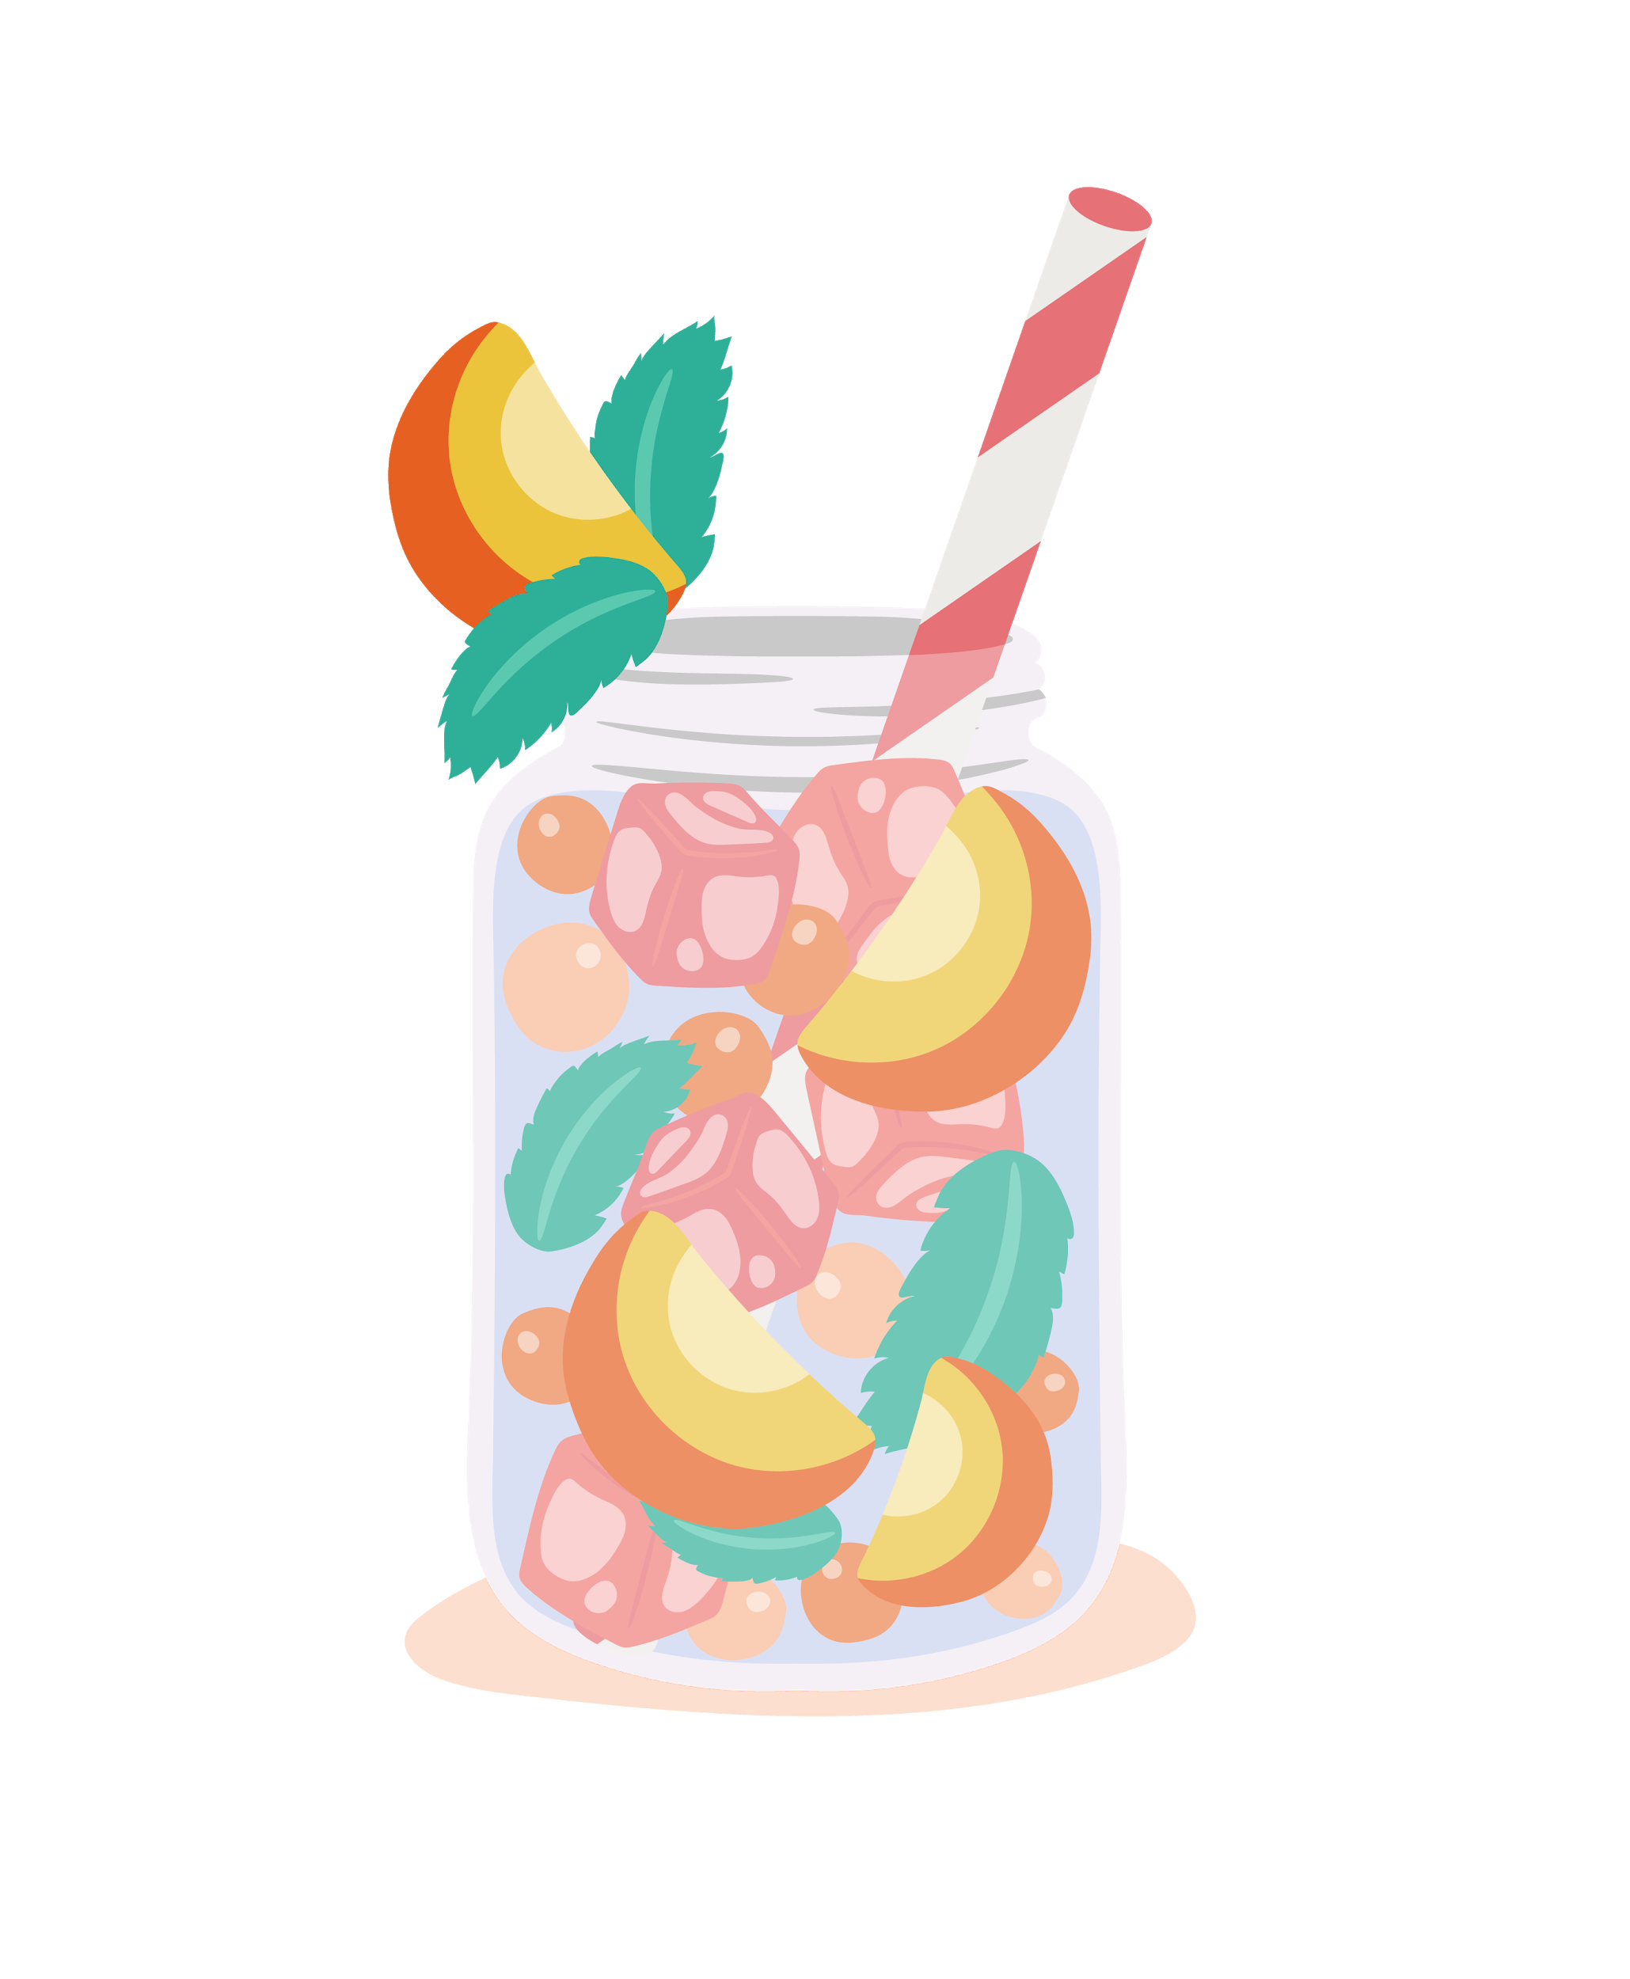
Text mining on brand attributes
Frequency of attributes - People who don't use yogurt to cook
Frequency of attributes - People who don't use yogurt to cook
Fage
Chobani
Oikos
Fage exceeded in taste, texture, availability and flavor out of the three brands
Chobani had the best price
Oikos was the most organic
Fage exceeded in taste, texture and protein
Chobani had the best price
Oikos exceeded in flavor and availability
Fage
Chobani
Oikos

Slide 5

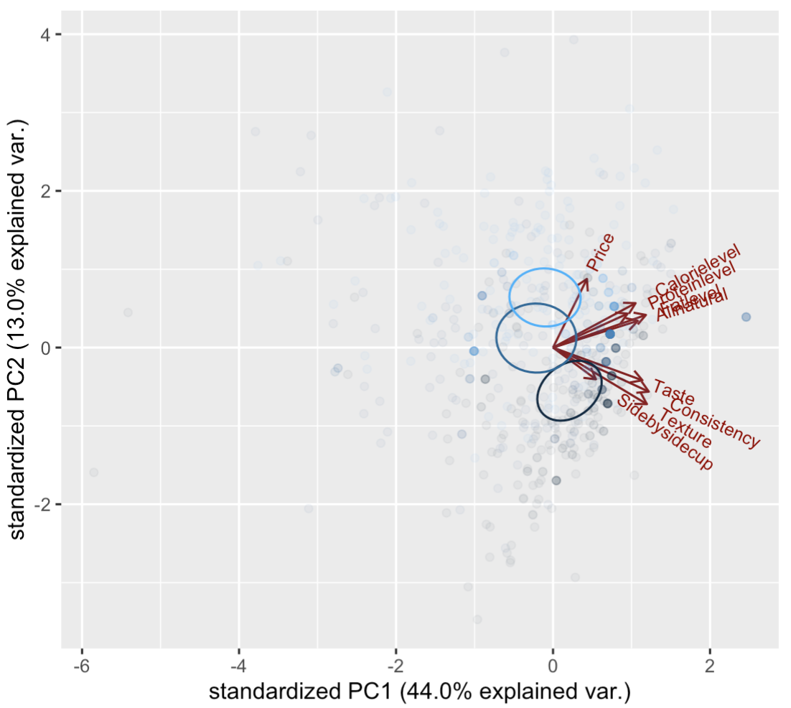

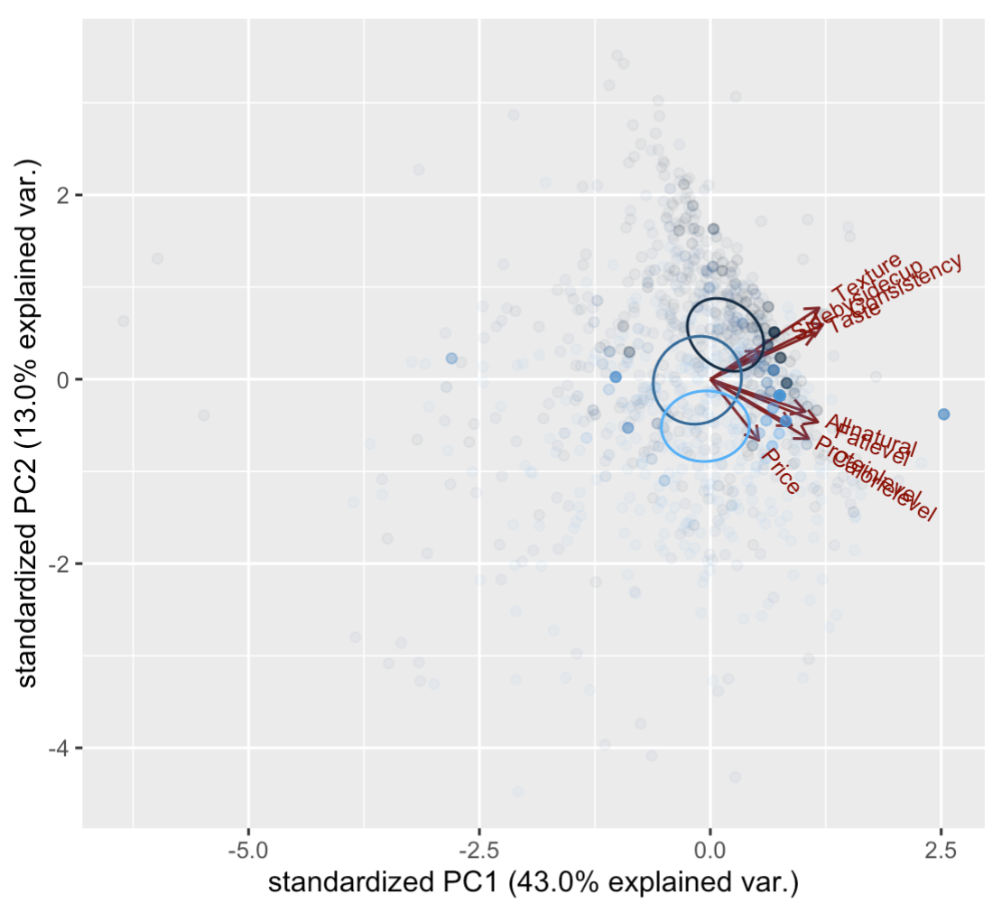
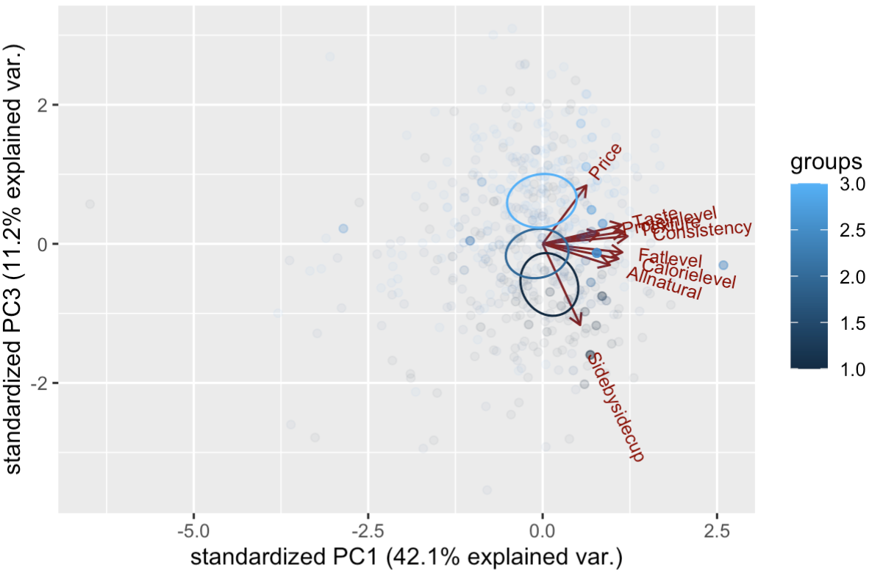

MARKET SEGMENTATION
Fage
Non-seperation
Chobani
Non-cooking
Oikos
Fage customers value texture, consistency and taste.
Chobani customers value all nature, fat level and calories level.
Oikos customers value price most.
Fage customers using for non-cooking value side by side cup.
Chobani customers value all nature, fat level, texture, consistency and taste.
Oikos customers value price most.
Cooking
Fage customers using for cooking value texture, consistency and taste.
Chobani customers using for cooking value all nature, fat level and calories level.
Oikos customers using for cooking value price most.

Slide 6
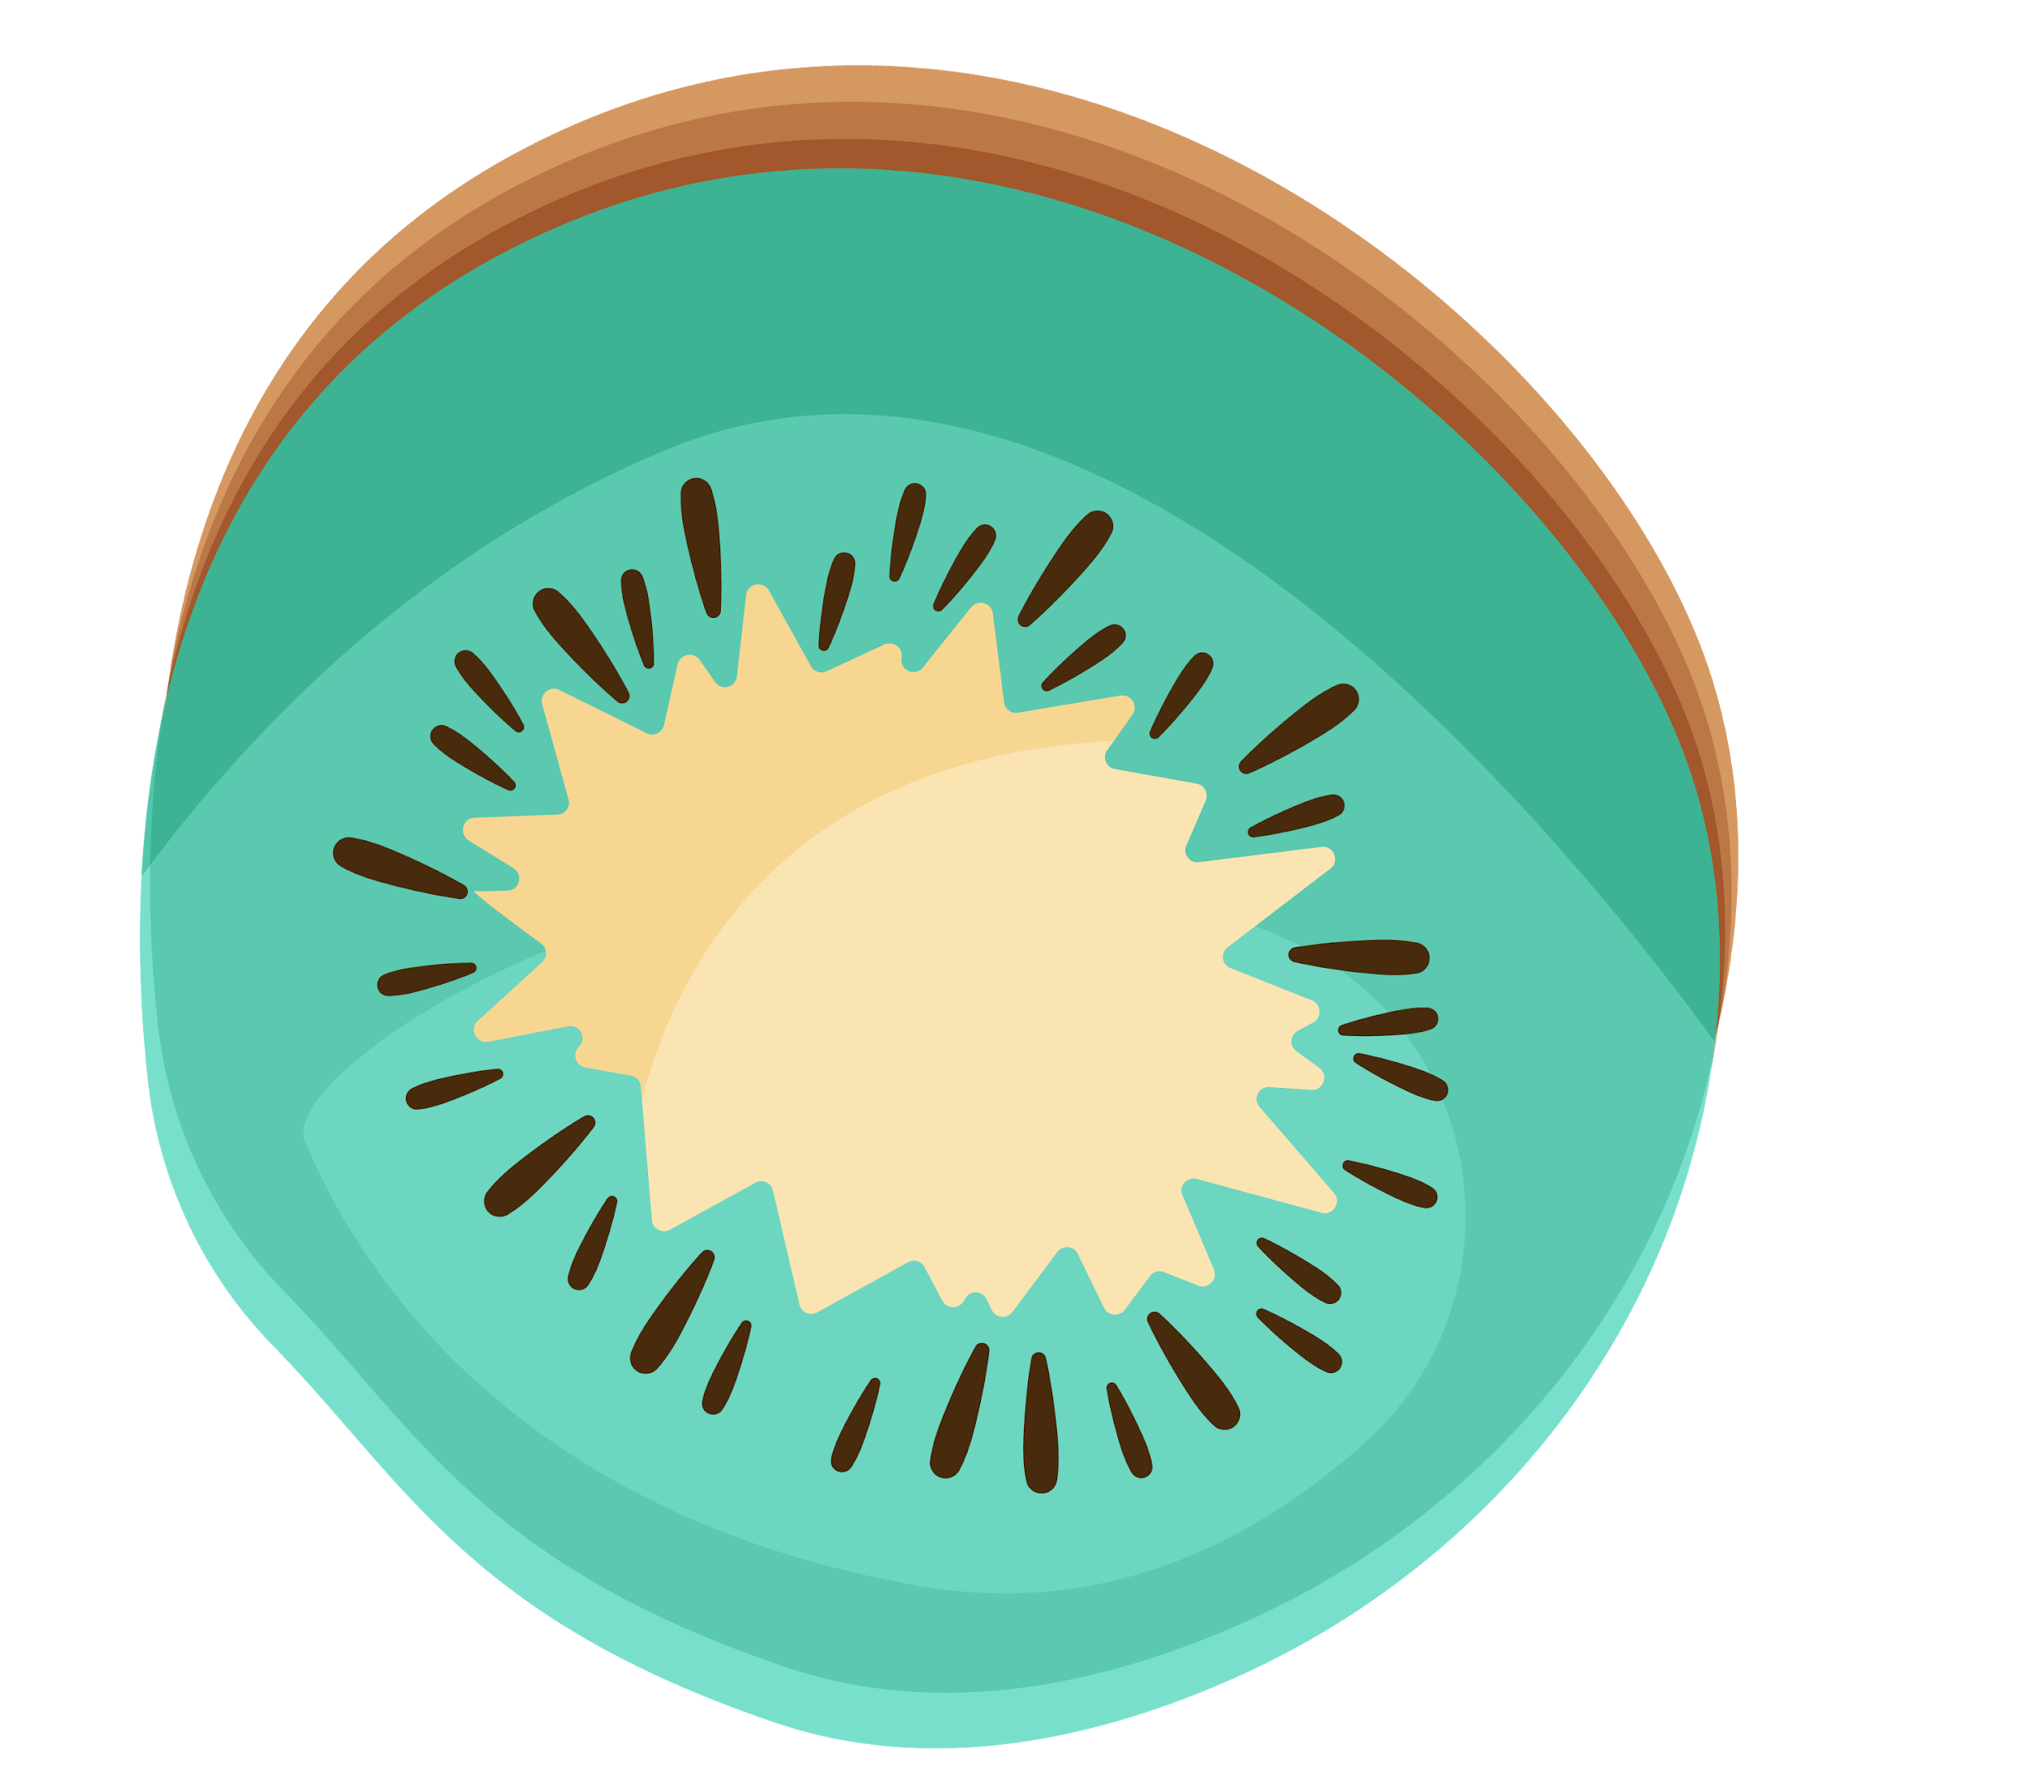

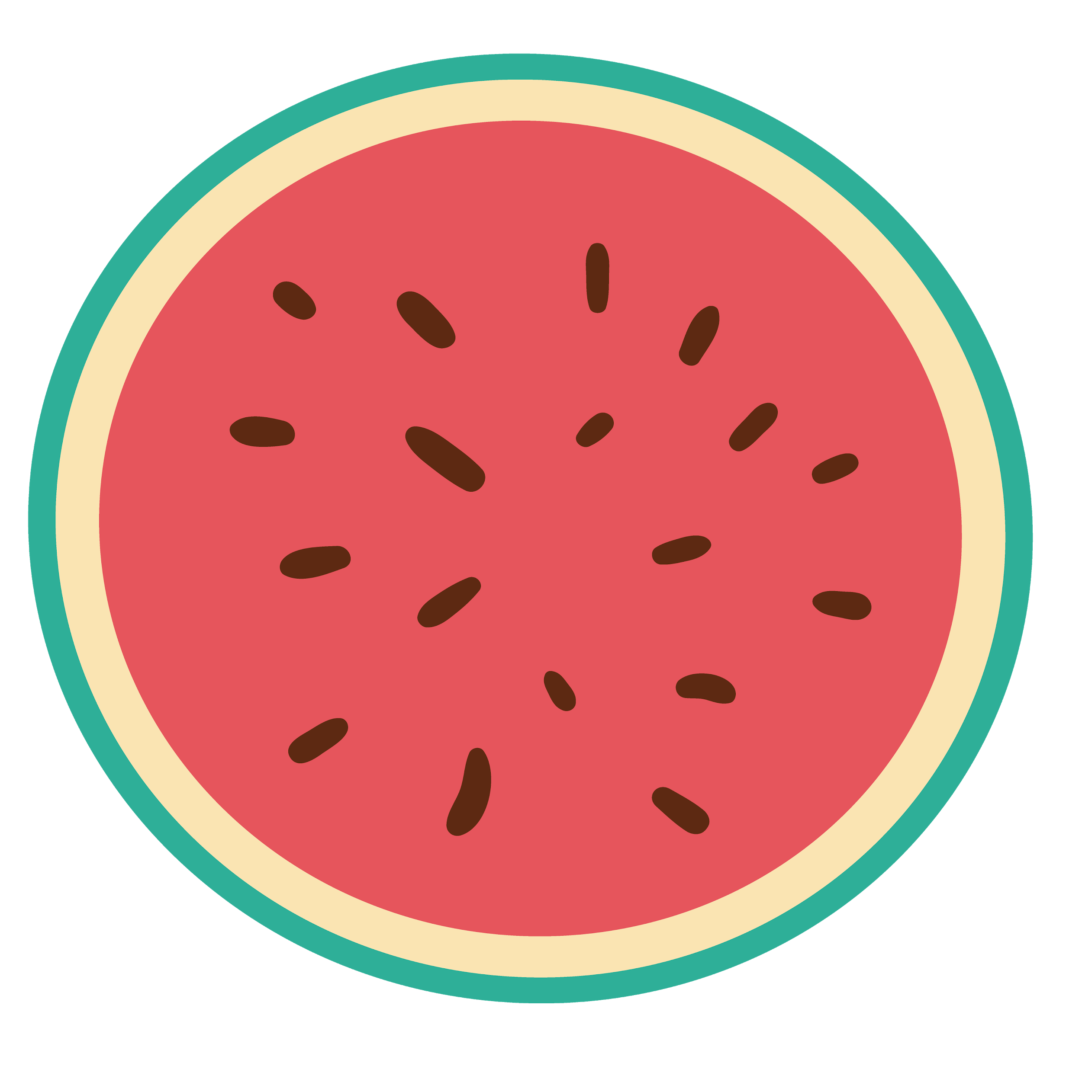
Summary
There is no apparent difference on distinct features between customers who prefer to use yogurt to cook or snack.
Both Chaboni and Oisko attract customers by the price, but Chaboni will also attract customers by its health feature
02
Most customers rank taste as highest feature while choosing brand.
04
01
Customer will focus on taste, ingredient, health, and price while choosing the yogurt.
03
05
Fage perform most satisfactory on taste among three brands.

Slide 7

THANKS

